Slide 1

Automation with dr
Andreas Sobczyk

Slide 2

Andreas Sobczyk
IT Consultant at Danish Broadcast Corporation
Cloud & Datacenter Specialist focusing, System Center, Azure, PowerShell
MCSE: Private Cloud, MCTS: Hyper-V
Mail: asob@dr.dk
Twitter: @Andreas_Sobczyk

Slide 3
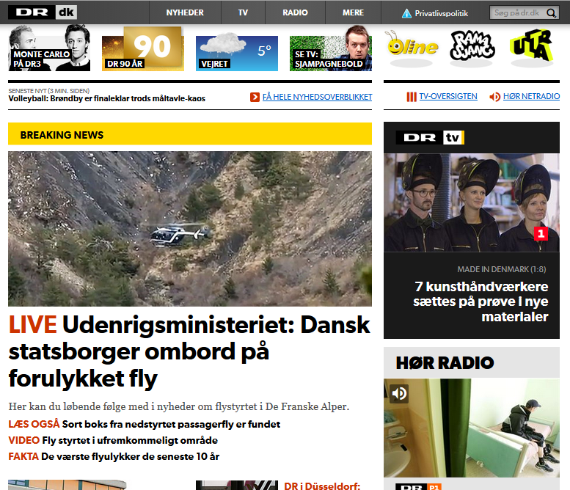
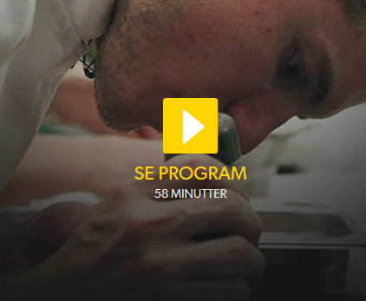
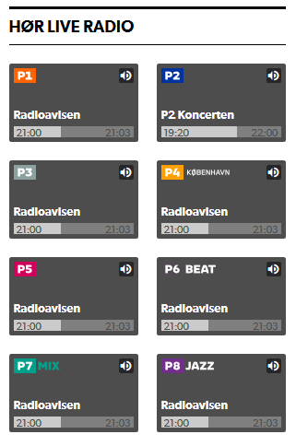
DR’s Infrastructure
Microsoft & System Center as the strategic platform for Private Cloud
1.000 Windows servers
350 Redhat Linux servers
Various cloud services like, Azure, AWS, Akamai
DR Media archive
Est. 5 petabytes audio and video
175.800 video files equal to 717.282 Hours
1.614.716 audio files equal to ca. 1 mill Hours
dr.dk
Third biggest website in DK
Video streaming est. 220.000 hours daily (7-8 petabytes/month)
Radio streaming est. 315.000 hours daily
Notes:
Hvor mange bruger automation i det daglige? - resten på være lige som den næste gut.

Slide 4


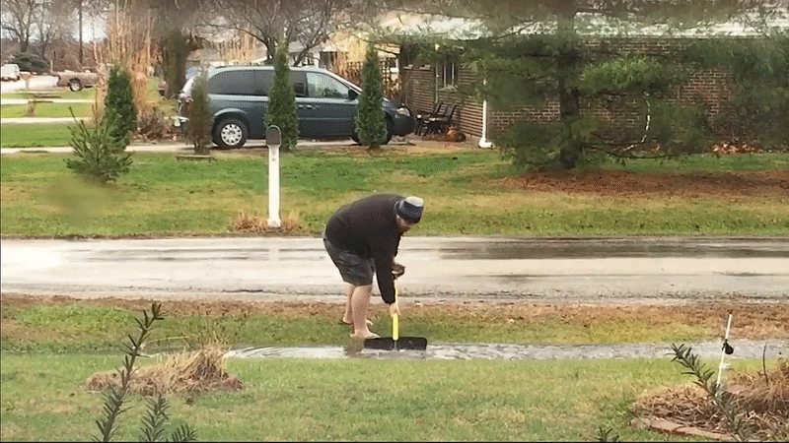
SERVICE MANAGER

Slide 5

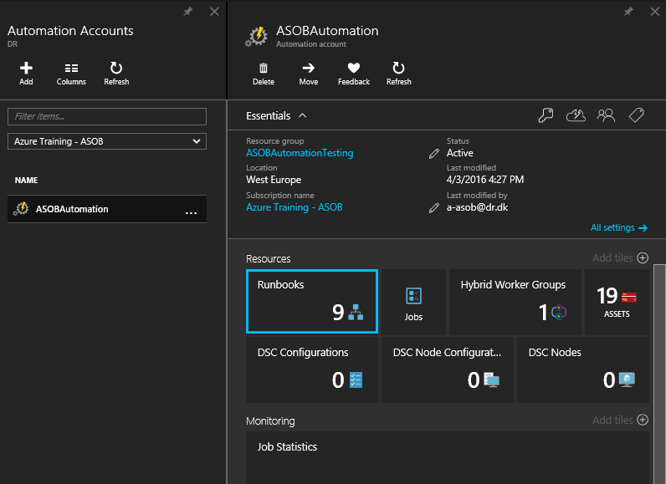
Azure Automation Overview
Part of the Operations Management Suite
Managed Automation Service running in Azure
PowerShell Based
Highly Available

Slide 6
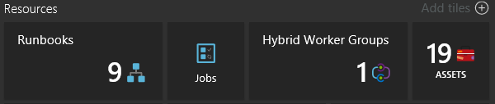
Azure Automation Concepts
Automation Account
Runbooks
Jobs
Hybrid Workers
Assets

Slide 7
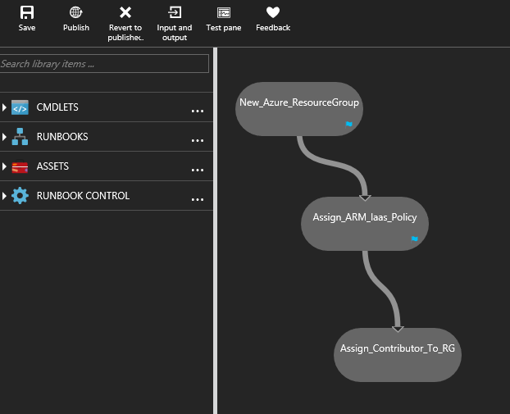
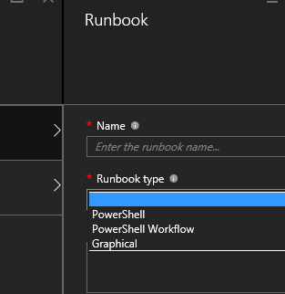
Runbooks
PowerShell Workflow
PowerShell Scripts
Graphical (Workflow Based)
Notes:
PowerShell Workflows – based on Windows Workflow Foundation. Taking some time to compile. Pros: Checkpoints and parallel execution.
PowerShell Scripts – Normal PowerShell Scripts. Instant execution.
Graphical runbooks – based on PowerShell Workflows. Taking some time to compile. Pros: Checkpoints and parallel execution.

Slide 8
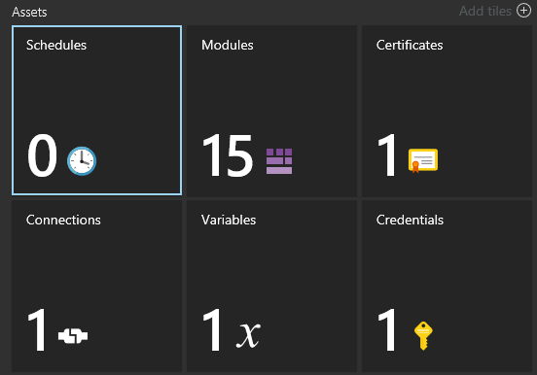
Assets
Notes:
Modules must contain all PowerShell modules used in scripts.
Use variables as much as possible, don’t hardcode stuff into runbooks.

Slide 9
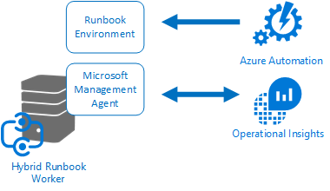
Hybrid Workers
Execute Runbook in your own datacenter
Requires an OMS Account
Based on Microsoft Monitoring Agent (SCOM)
No need inbound firewall openings

Slide 10
DEMO
Notes:
Show Portal
Show Runbooks

Slide 11
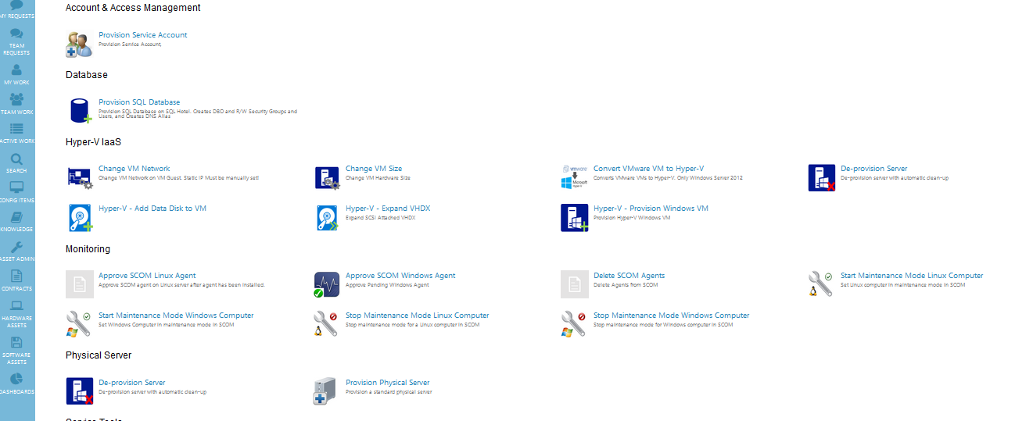
Requests & Self-Service
Notes:
For at effektuere vores business service concept har vi gjort stor brug af automatisering.
Det sikre at data I CMDB’en bliver oprettet korrekt og ingen steps bliver skippet.
For 1½ år siden var der lige så mange måder at deploy servere og databaser som der var medarbejdere. Nu er der kun en og det er via Service Manager og der står altid hvem der har gjort hvad hvornår, samt hvilket business service serveren eller database tilhøre da alle requests skal relateres til en service.
Til vores hyper-v platform har vi valgt at låse det helt ned således at det kun er de 2 Hyper-V administrator der har adgang til at ændre I installationen og deploy VMer direkte via konsolen.
Det vil sige at alle oprettelser og ændringer sker via self-service portalen.
VIS PORTALEN

Slide 12
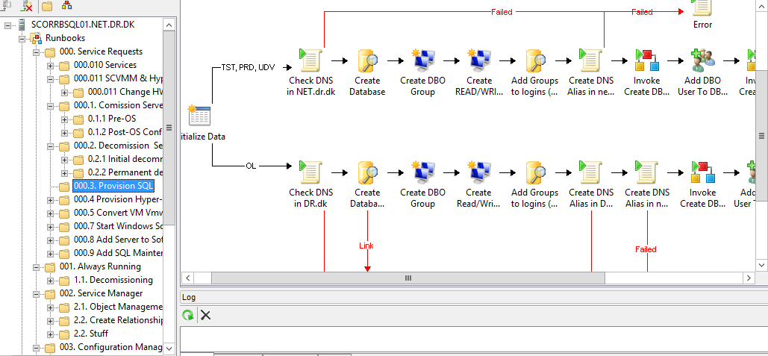
How to get started Self-Service
Notes:
Start med nogle simple requests.. Approve og delete SCOM Agents… Udvid VHD… Set computer I MM.
Tegn det op I visio, template eksempel kan sendes ,eller skriv den ned.
Find ud af hvilken input parameter der er brug for og hvordan de skal indtastes.
Opbyg runbooks så modulært som muligt, små runbooks der med funktioner der kan genbruges. og lav dem så vidt muligt deklerative.
Brug powershell så meget som muligt for nemt at flytte over I Workflows

Slide 13


Questions Mail: asob@dr.dk Twitter: @Andreas_Sobczyk

